Slide 1
Melbourne House Price Prediction
Abdullah All Mamun
M.Sc in Data Science
Beuth University of Applied Science
ID: 902258

Slide 2
Short Introduction
Dataset
Data Preprocessing
Data Visualisation
Feature selection
Predective modeling
Hyperparameter Tuning
Performance Metrics

Slide 3
Dataset
Kaggle Dataset
34,857 records with 21 attributes
Attributes information:
SellerG: Real Estate Agent
Date: Date sold
Distance: Distance from CBD in Kilometres
Regionname: General Region (West, North West, North, North east …etc)
Propertycount: Number of properties that exist in the suburb.
Bedroom2 : Scraped # of Bedrooms (from different source)
Bathroom: Number of Bathrooms
Car: Number of carspots
Landsize: Land Size in Metres
Suburb: Suburb
Address: Address
Rooms: Number of rooms
Price: Price in Australian dollars
Method:
Type:
BuildingArea: Building Size in Metres
YearBuilt: Year the house was built
CouncilArea: Governing council for the area
Lattitude: Self explanitory
Longtitude: Self explanitory

Slide 4
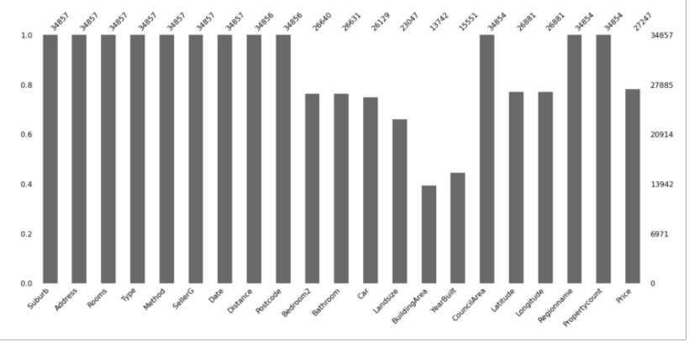
Data Preprocessing
Missing values Handling
Missing values of price are dropped
Missing values of Bathroom and car are filled using medians
Features having missing values are dropped

Slide 5
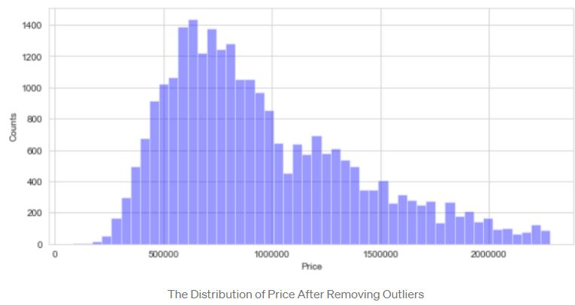
Outliers Handling
Using Interquartile Range
Drop if data points falls above the 3rd quartile and below the 1st quartile
Price $635000 and $1295000
Rooms – 2 rooms and 4 rooms
Distance-6.4 kilometers and 14 kilometers
Bathroom- 1 and 2 rooms
Car- 1 and 2 spots

Slide 6
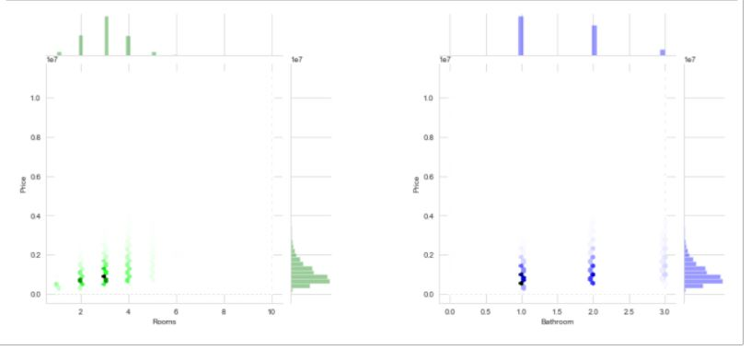
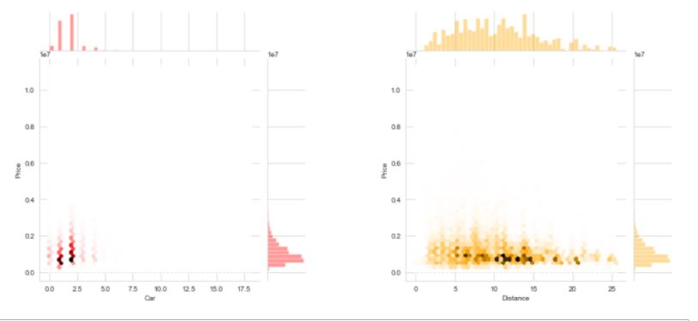
Exploratory Data Analysis(EDA)

Slide 7
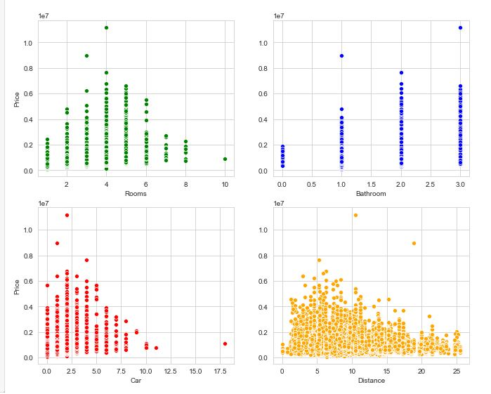
Rooms Vs Price
Bathroom Vs Price
Car Vs Price
Distance Vs Price

Slide 8
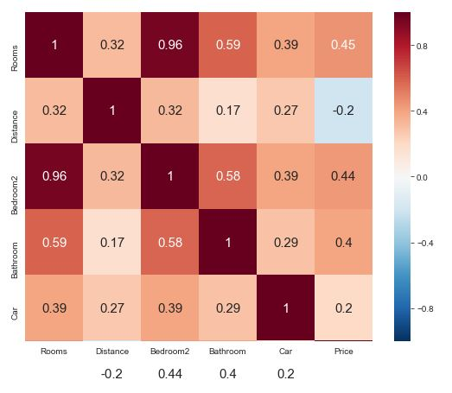
Heatmap

Slide 9
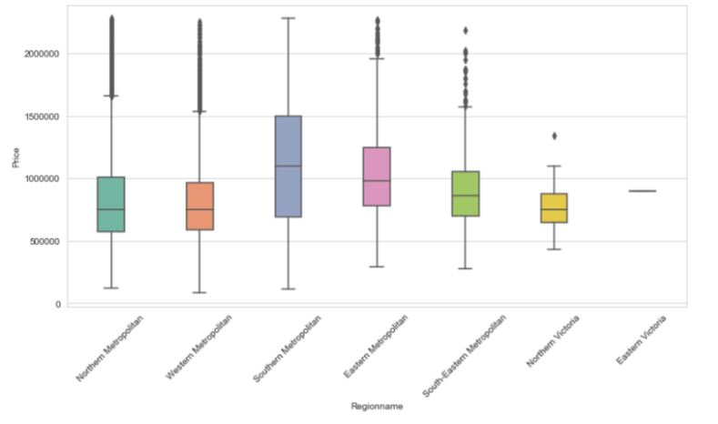
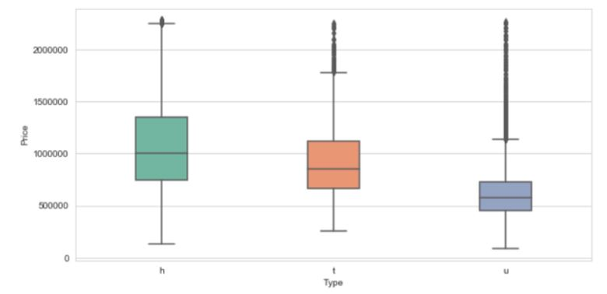
Categorical Features
Regionname and Type
H=House, cottage; t=townhouse; u=unit, duplex

Slide 10
Predictive Modeling
Machine learning model
Linear Regression
Ridge Regression
K-Nearest Neighbors
Decision Tree
Performance Metrics
Coeffiecient of Determination
MSE(Mean Squared Error)

Slide 11
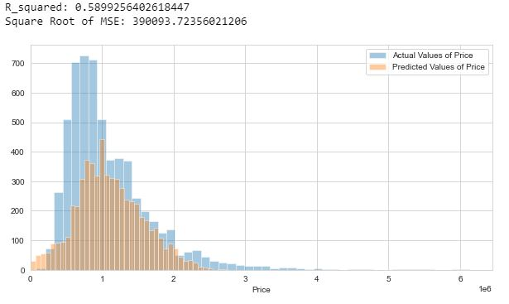
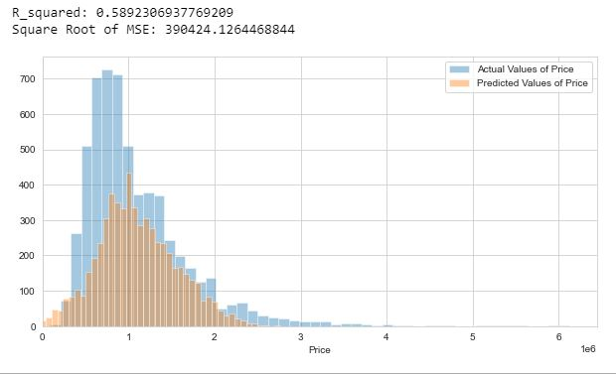
Linear and ridge regression
Linear regression
Ridge regression

Slide 12
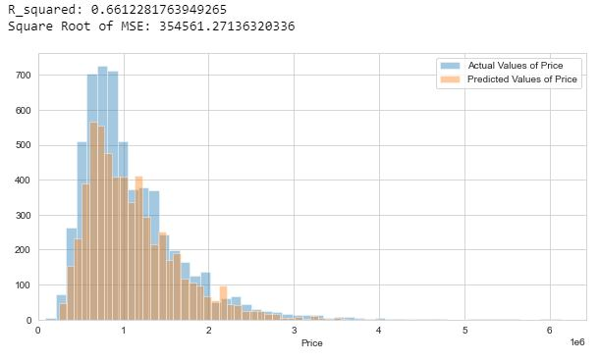
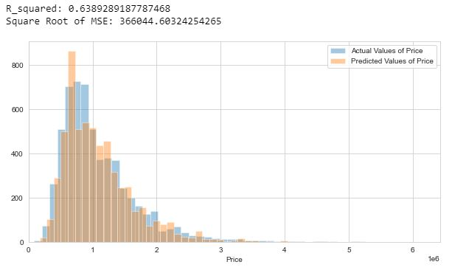
KNN and Decision TRee
Knn
Decision Tree

Slide 13
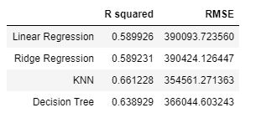
Performance Summary

Slide 14
Cross Validation and Grid Search
Cross validation
Grid Search
Re-sampling procedure
Data splits into k-folds
Fit a model using (k-1) folds and validate the model using the remaining fold
Find the average of the score
Hyper parameters tunning to find the optimal values of the parameters for a model

Slide 15
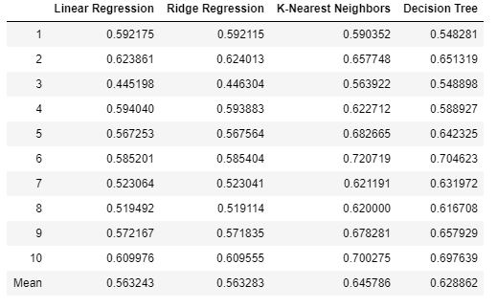
Cross validation summary after parameter tuning

Slide 16
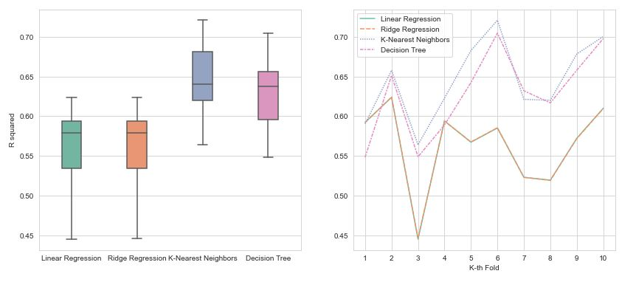
Boxplot and line plot for the perfomance

Slide 17
The End

